Slide 1
Amphipod Density as a Biological Indicator of Wetland Quality in the Prairie Pothole Region of North Dakota
Mark T. Wiltermuth^{1,2}, Michael J. Anteau¹,
Mark E. Clark², Johann A. Walker³
¹ US Geological Survey, Northern Prairie Wildlife Research Center, Jamestown, ND
² North Dakota State University, Environmental and Conservation Sciences Program, Fargo, ND
³ Ducks Unlimited, Great Plains Regional Office, Bismarck ND

Slide 2
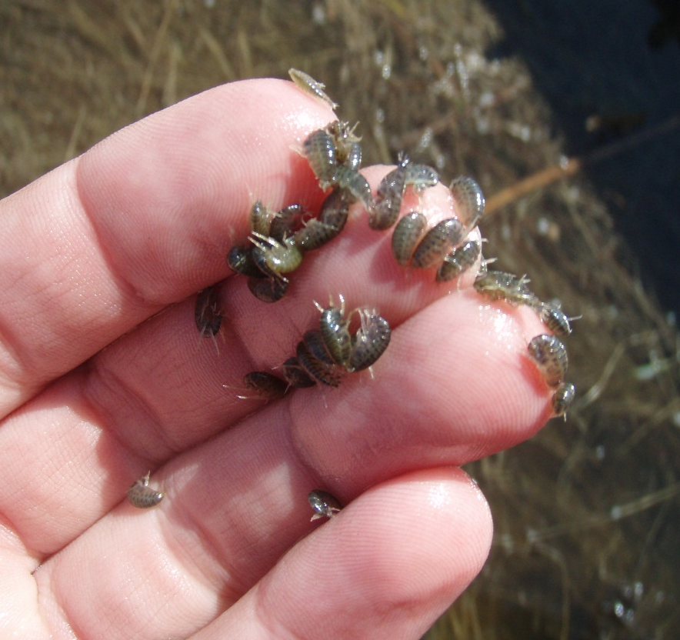
Biological Indicators
Amphipods are good indicators of wetland and water quality because they are common and sensitive to contaminants, disturbance in uplands, and invasive species

Slide 3
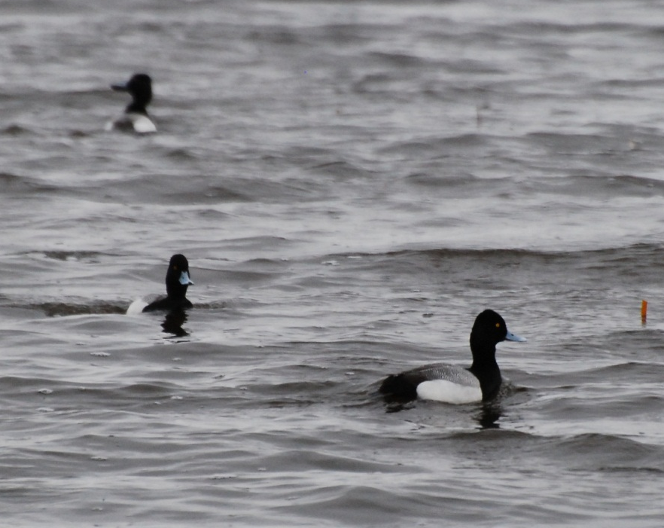

Wetland and Water Quality
Wetland quality: ability to support diverse communities of plants, invertebrates, and vertebrates
Perform multiple ecological services: floodwater storage, improvement of water quality, reduction of soil erosion and sedimentation, carbon sequestration
Water quality: provide a
suitable environment for
diverse communities
Metric of interest:
Chlorophyll a

Slide 4
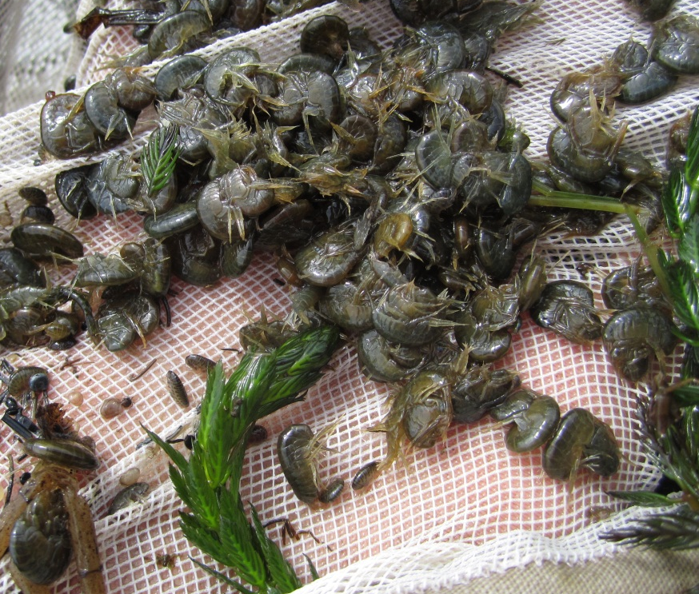
Wetland Productivity
Understanding the link between inter-annual hydrologic dynamics and landscape modifications is prerequisite to modeling effects of climate and land use change on the function and productivity of prairie wetlands
Water level fluctuations are
important processes that
regulate productivity

Slide 5
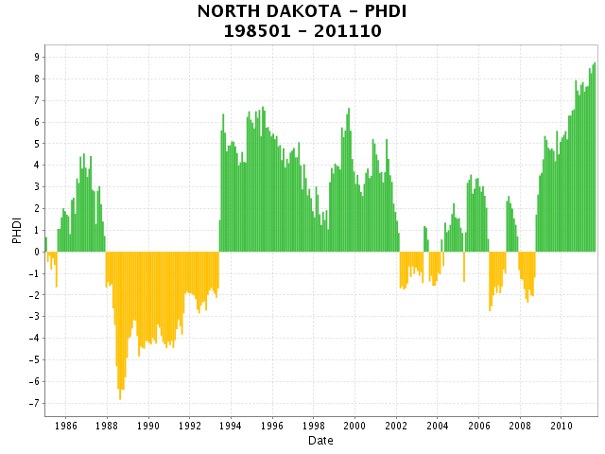
Climate Cycles
Palmer Hydrologic Drought Index
State of North Dakota Jan 1985 to Aug 2011

Slide 6
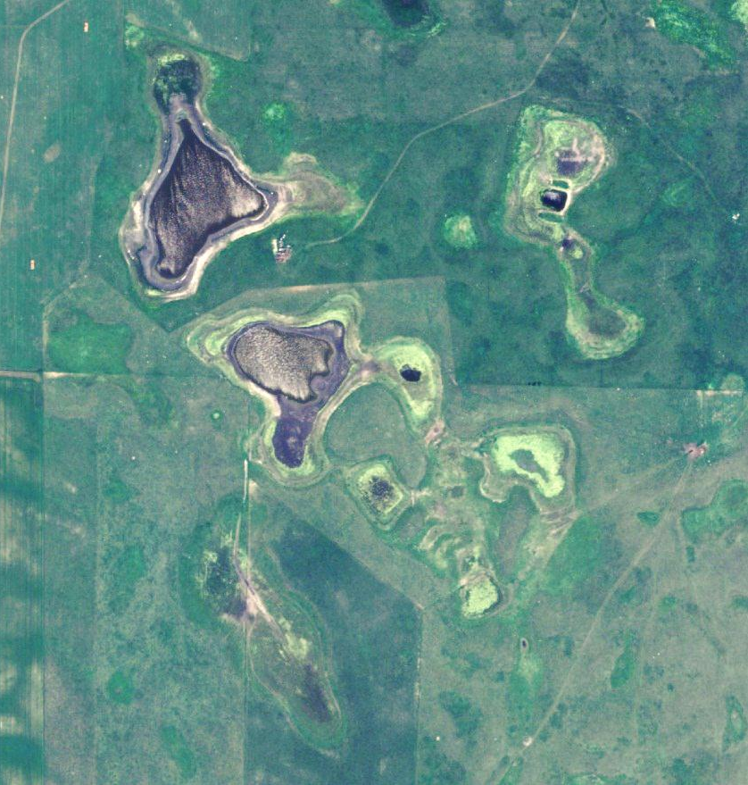
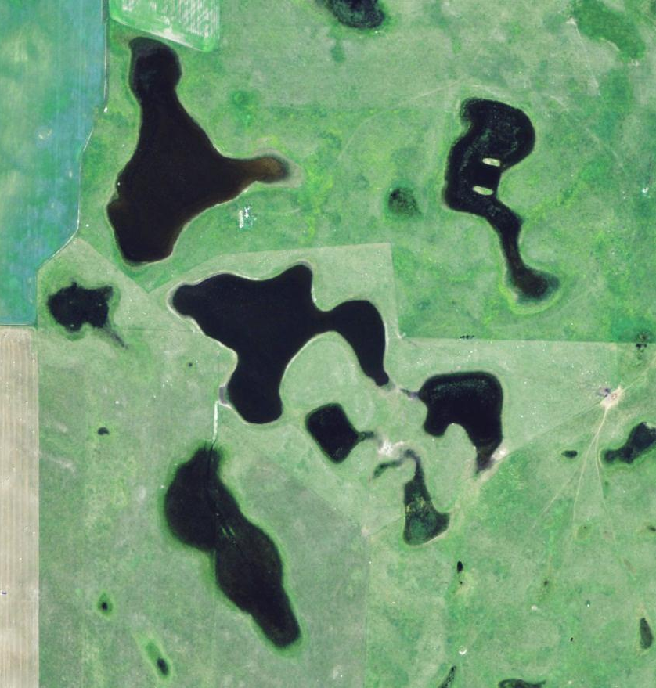
Climate Cycles: Period Comparison
2005
2010
Notes:
Basin of the two larger wetlands in 2010 is approx 4.5 ha

Slide 7
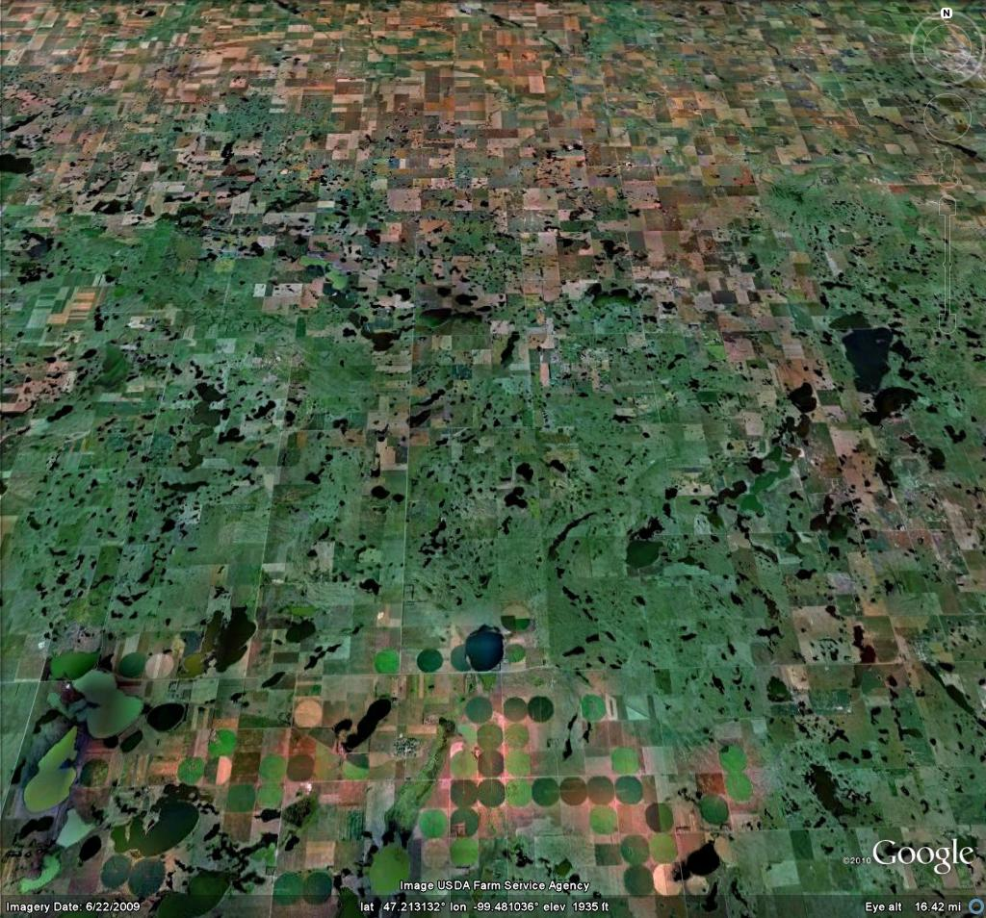
Landscape Modifications
Increased agriculture intensity over the past century has decreased the number and quality of wetlands
Landscape modifications have impacted prairie wetlands by:
  increasing surface-water connections
  increasing in sedimentation and contamination of wetlands
  improve conditions for invasive fishes and vegetation

Slide 8
Objectives of Two Studies
Amphipod Density
  Water level change
  Landscape Modification
  Occurrence and abundance of fish and cattail
Chlorophyll a
  Remotely sense Chlorophyll a concentration
  Test Alternative Equilibria Hypothesis on a landscape scale (1,000 wetlands)
  Predict chlorophyll a and amphipod densities from landscape characteristics

Slide 9
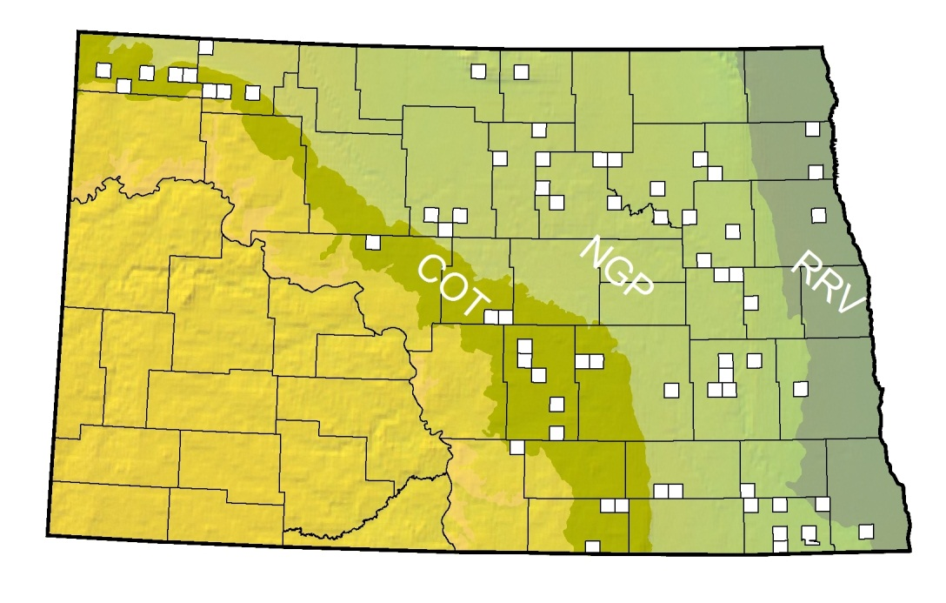
Study Area
Three physiographic regions, North Dakota:
  Red River Valley
  Northern Glaciated Plains
  Missouri Coteau
Randomly selected townships
Sampled 3 wetlands in each selected township
Revisited randomly selected wetlands initially sampled in 2004-2005 (Anteau and Afton, Wetlands 28:184–196)
Semipermanent and permanent wetlands > 4 ha
Notes:
Randomly selected townships candidates needed 200 hectares semiperm

Slide 10
Surrounding Land Use
Percent cropland within quarter mile (400m) of wetlands

Slide 11
Wetlands Sampled
Region | 2004/05 | 2010 | 2011 | All Years
Missouri Coteau | 48 | 51 | 47 | 44
Northern Glaciated Plains | 84 | 89 | 83 | 79
Red River Valley | 8 | 10 | 10 | 8
Cottonwood Lake Study Area | - | 3 | 3 | -
Total | 140 | 153 | 143 | 131

Slide 12
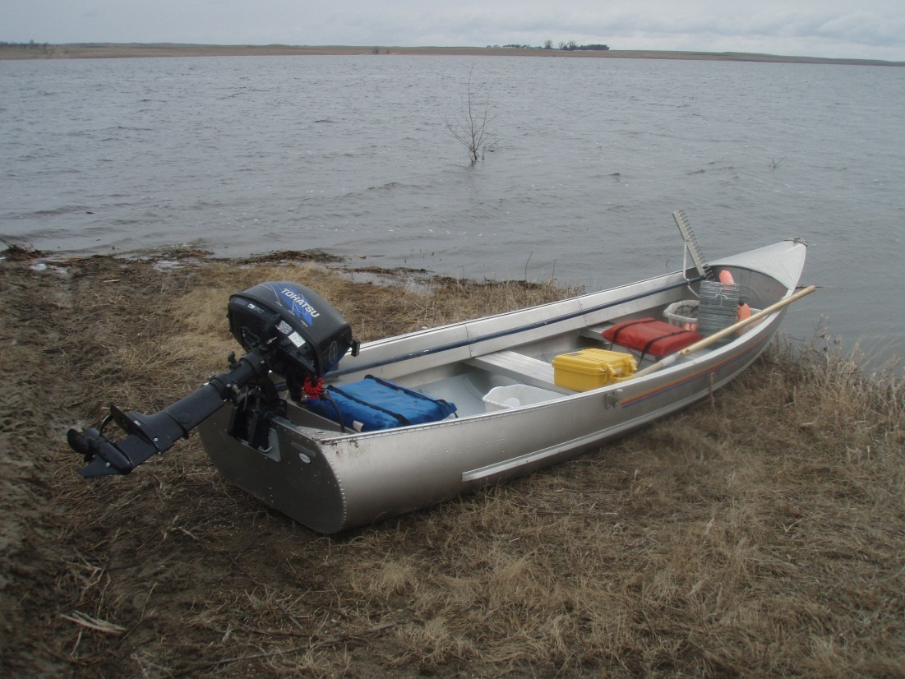
Data Collection
Anteau and Afton (Wetlands 28:184-196) conducted surveys in 2004–2005 during a drying phase immediately following a prolonged deluge phase; these data should represent low amphipod densities
In spring 2010–2011 we revisited these wetlands as the landscape retuned to wet conditions; these data should represent high amphipod densities

Slide 13
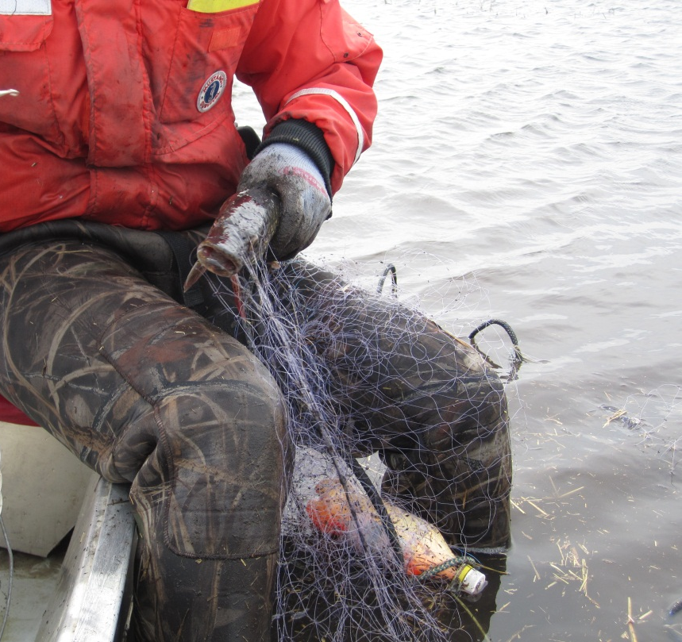
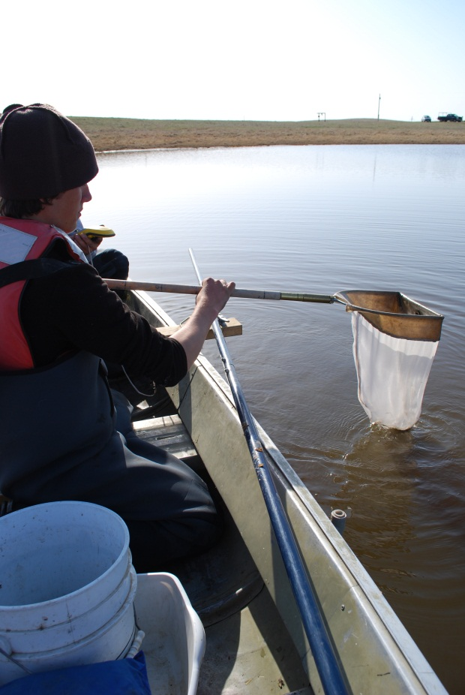
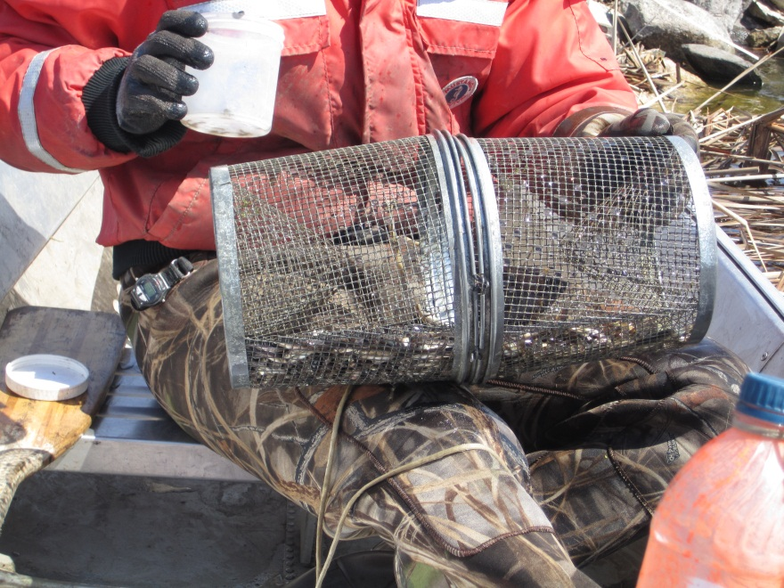
Wetland Surveys

Slide 14
Water-Level Change (±95% CI)
Region

Slide 15
Amphipod Density

Slide 16
Hyalella Mean Densities (±95% CI)
Region

Slide 17
Gammarus Mean Densities (±95% CI)
Region

Slide 18
Change in Hyalella Density
2004/05 to 2010
Change in Density m⁻³

Slide 19
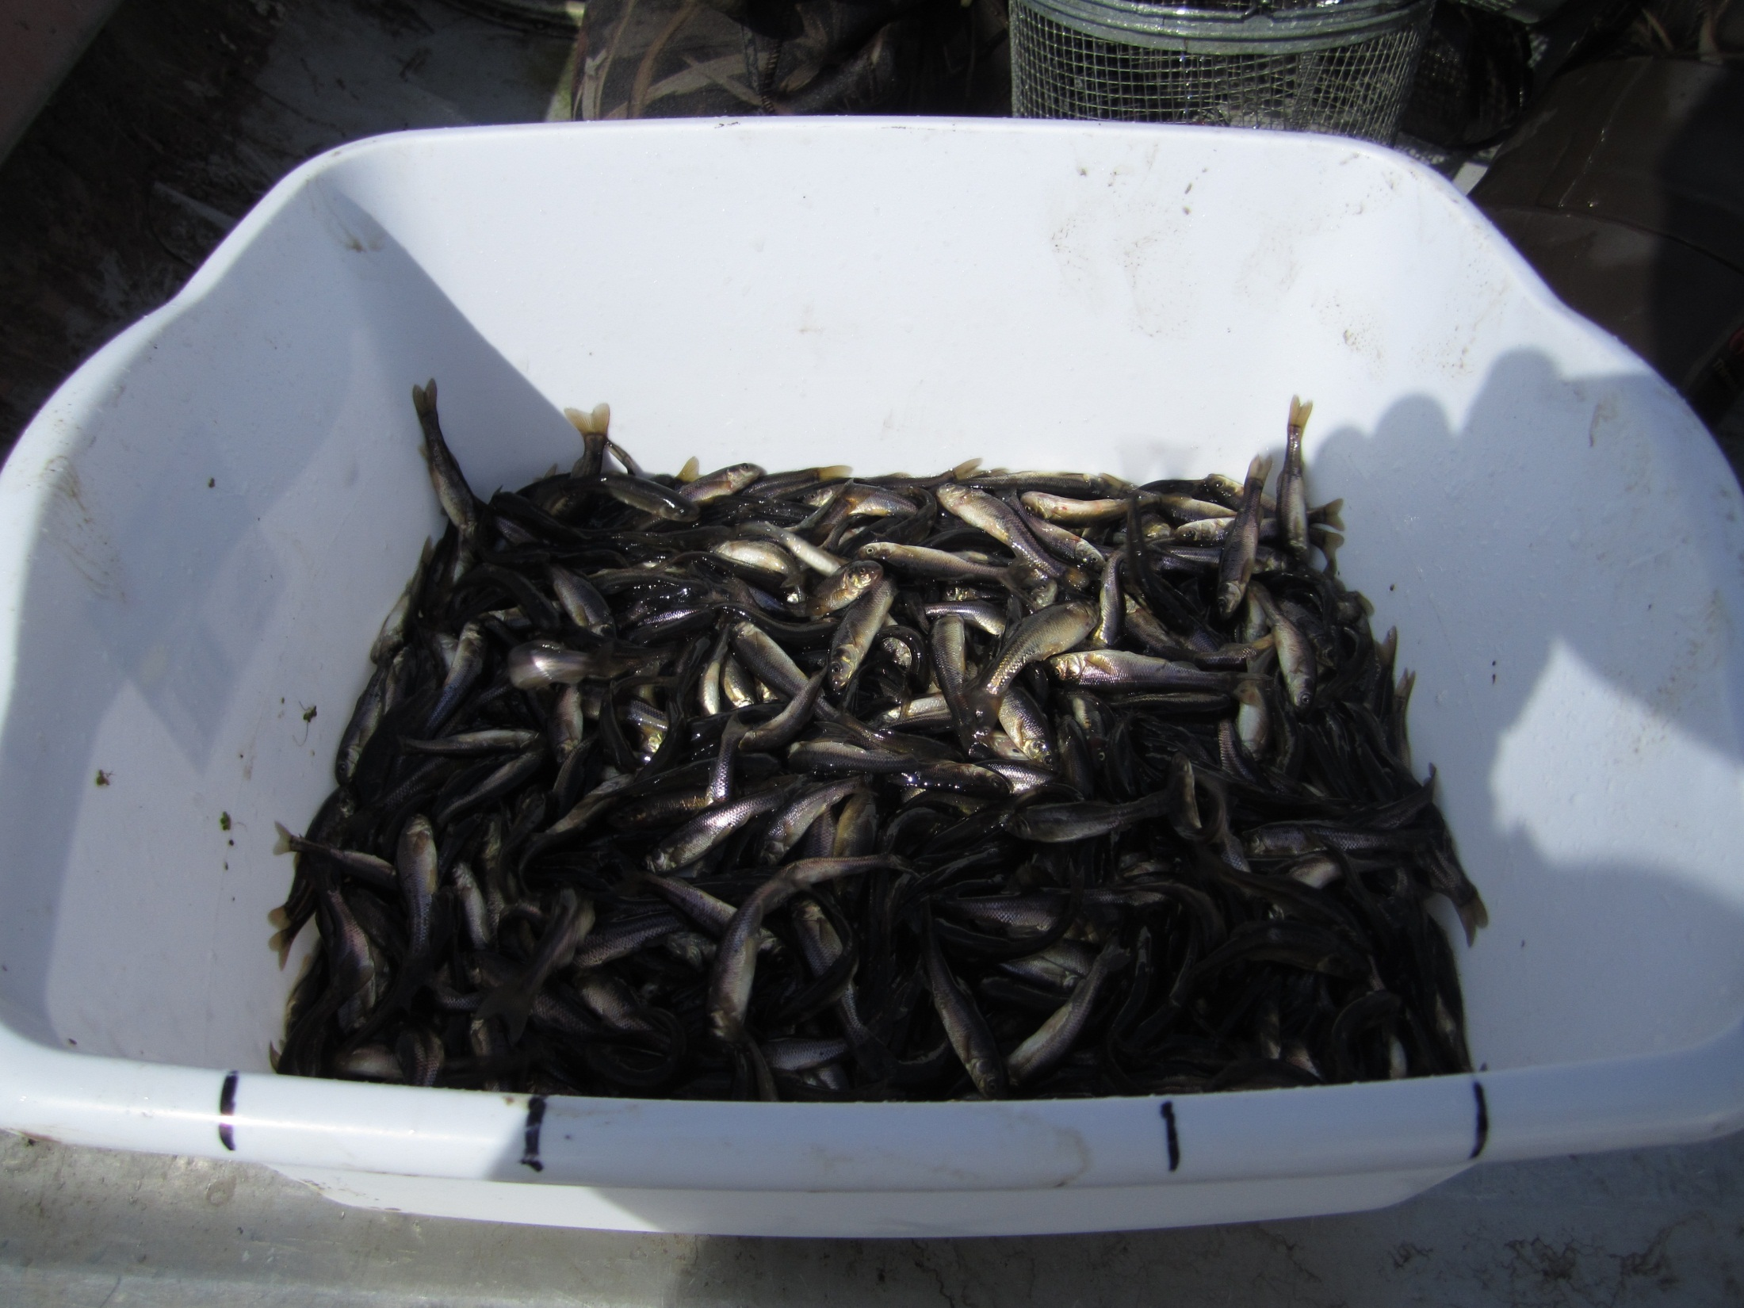
Are current water conditions better for fish?

Slide 20
Occurrence: Fish Group | 2004/05 | 2011
Fathead Minnow | 33% | 49%
Other Small Fish; Species typically <10 cm | 28% | 41%
Large Fish; >10 cm | 18% | 26%
Any Fish | 48% | 60%
n= 86

Slide 21
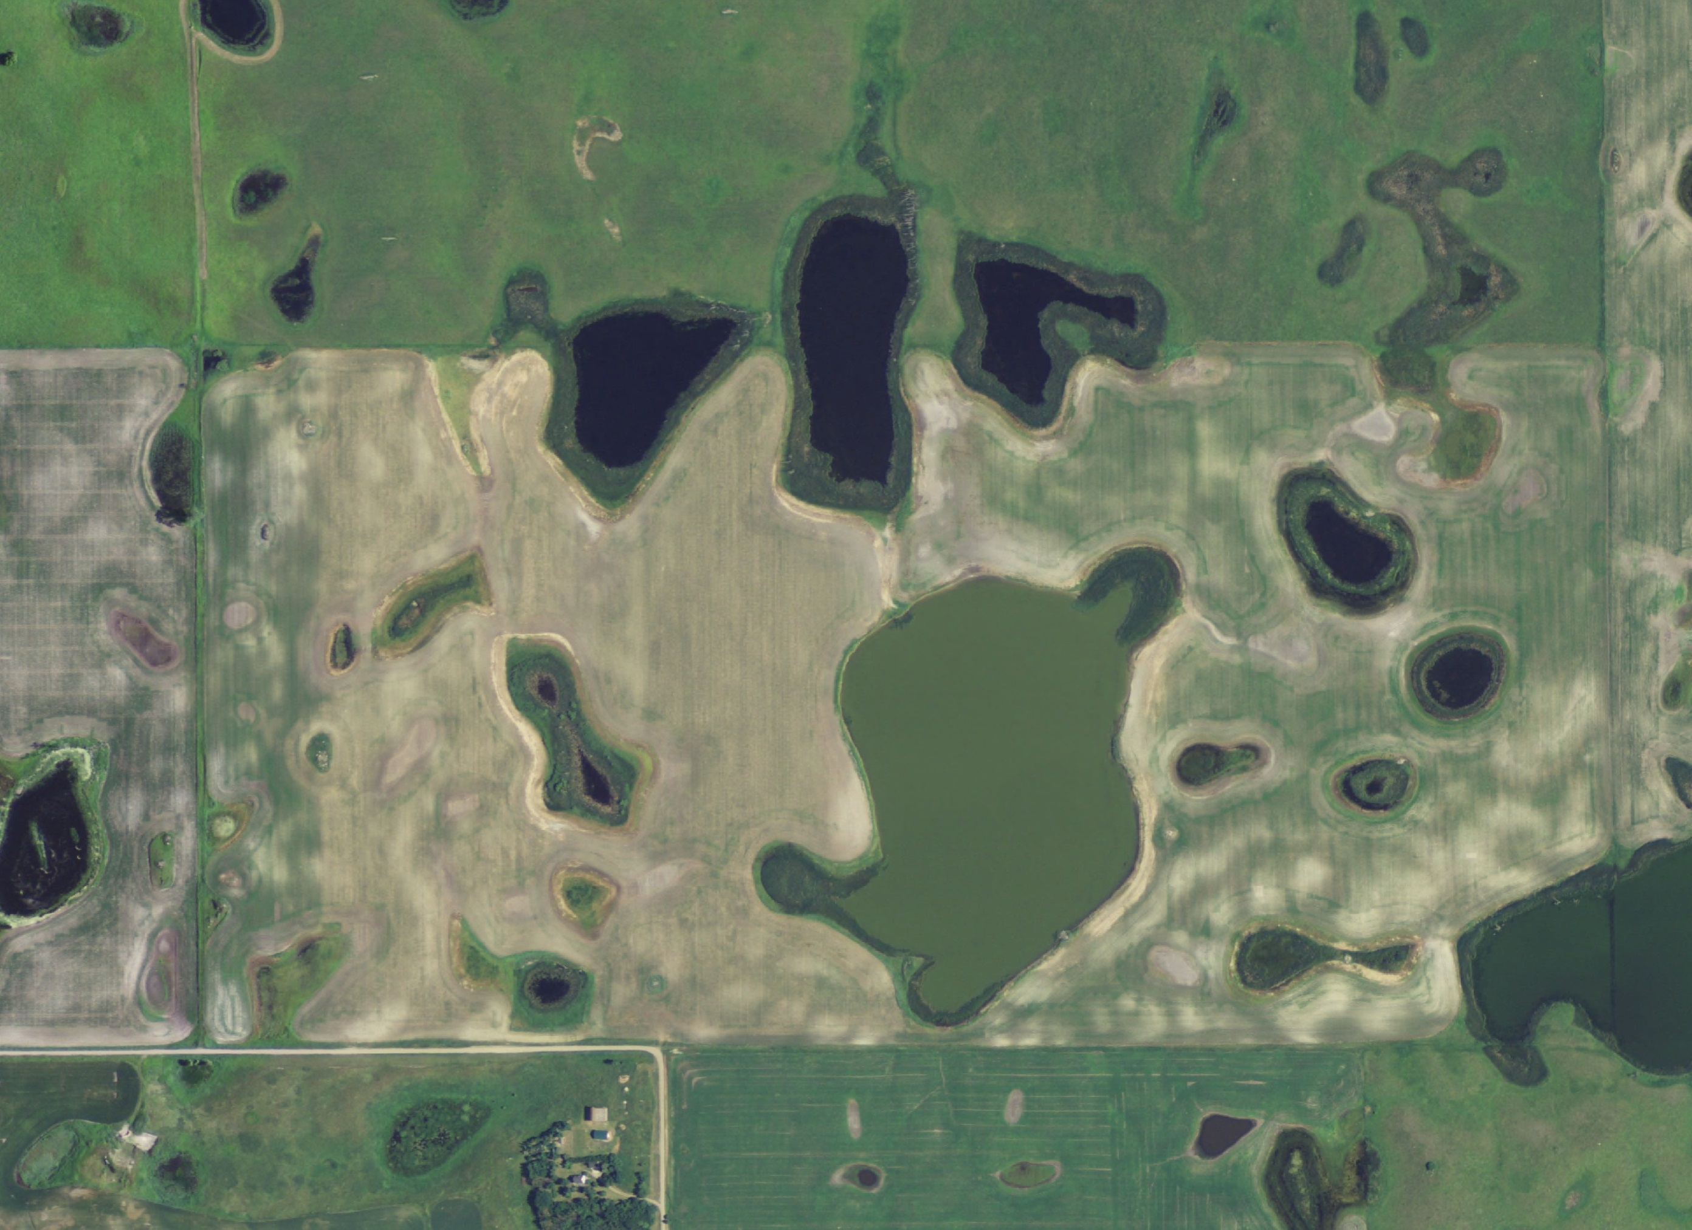

Slide 22
Chlorophyll a
Represents Phytoplankton Biomass
Alternative Equilibria Hypothesis
  Two Alternative States
  Community Dominated by Macrophytes
  Community Dominated by Phytoplankton
Clear wetlands support higher density of amphipods

Slide 23
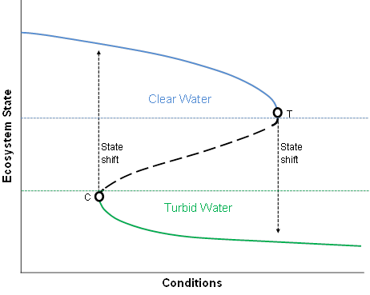
Alternative Equilibria
Modified from Scheffer et al. 2001

Slide 24
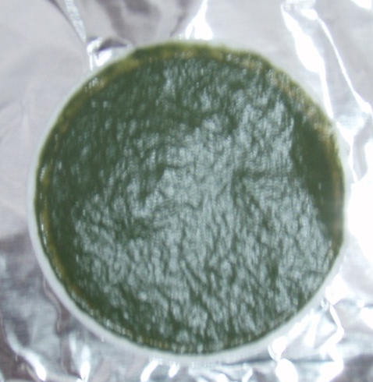
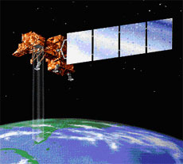
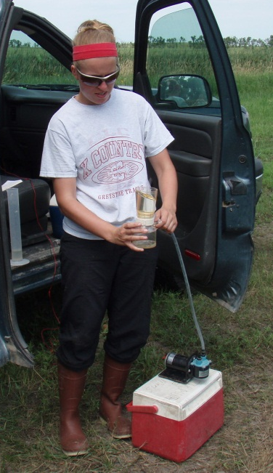
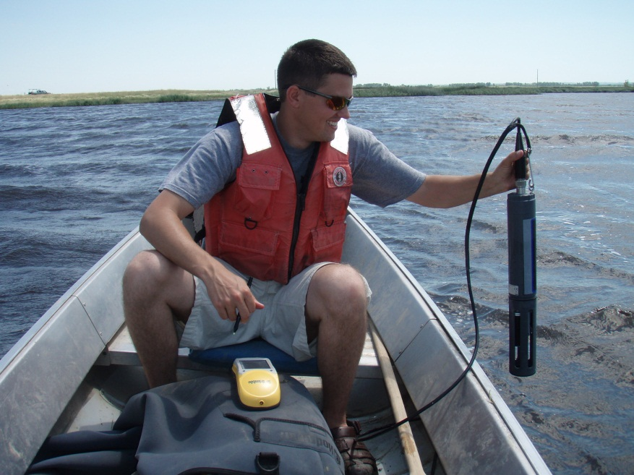
Three Methods of Measurement

Slide 25
Chlorophyll Measured
25 wetlands sampled
  Corresponding to cloud-free Landsat 5 TM
  (0-2 days)
40 Water samples collected for fluorometry
1,229 in situ measurements

Slide 26
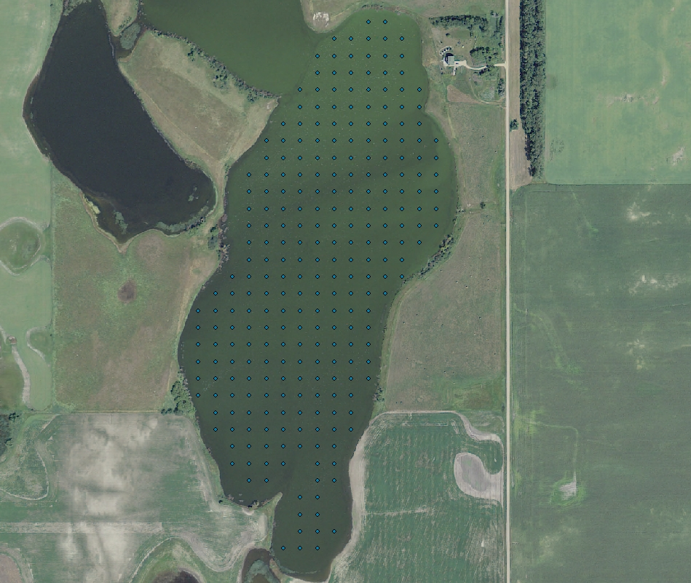

Slide 27
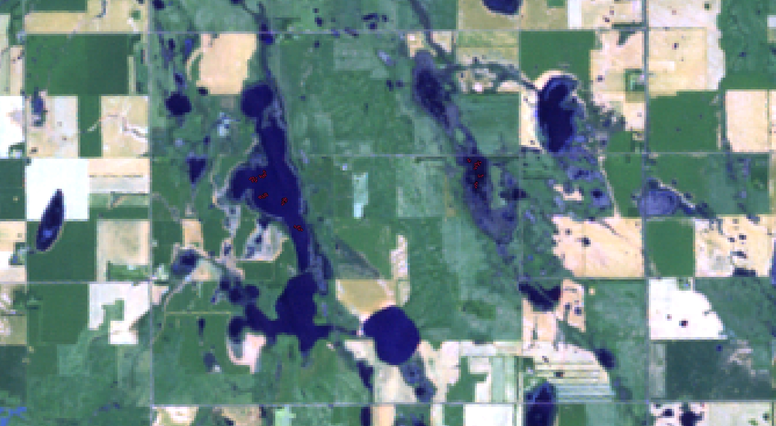

Slide 28
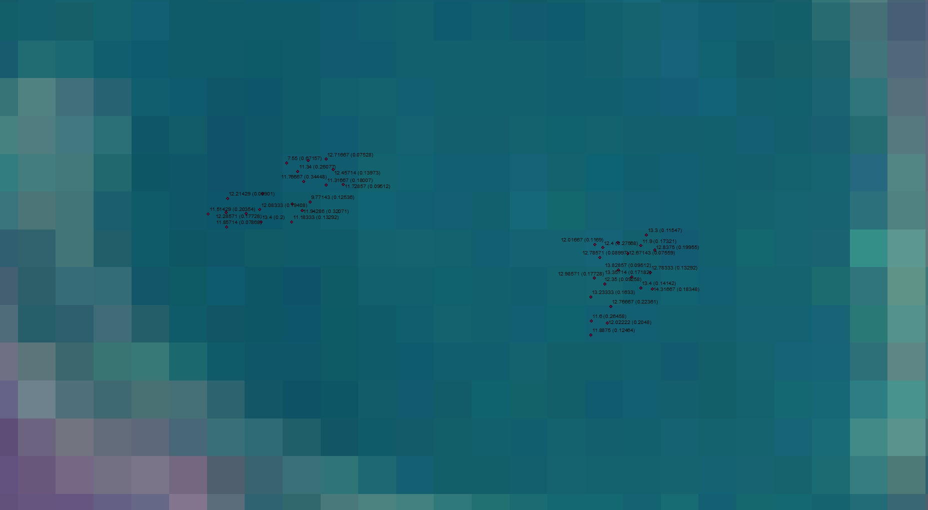

Slide 29
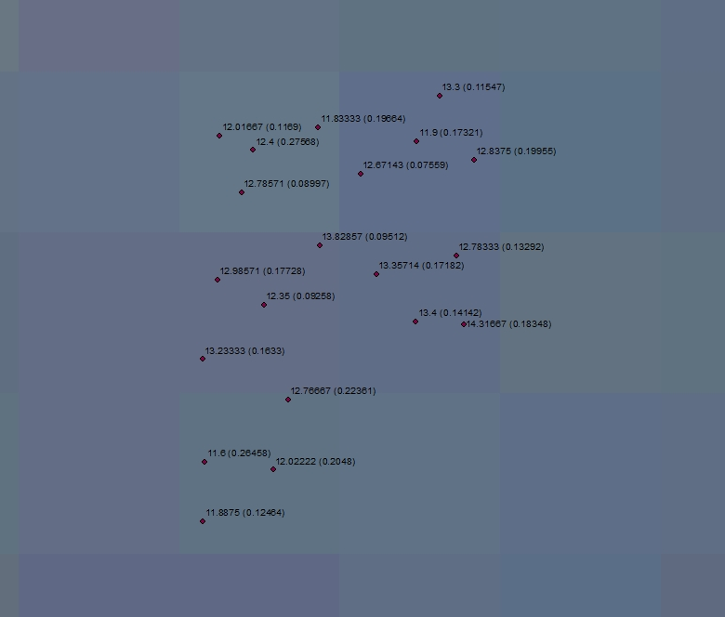

Slide 30
Next Steps:
Continue to develop remotely-sensed prediction of Chlorophyll a
Examine landscape and community factors that influence Chlorophyll a and Amphipod density
Further investigate the potential of Chlorophyll a to predict Amphipod density

Slide 31


Acknowledgements
Scott Stephens
Alan Afton
Funding and Support:
  State Wildlife Grants, North Dakota
  Dr. Bruce D. J. Batt Fellowship in Waterfowl Conservation, Institute for Wetland and Waterfowl Research, Ducks Unlimited Canada
  USGS Northern Prairie Wildlife Research Center
  USGS Youth Initiative, Student Career Experience Program
  USGS Landscape Conservation Cooperative Program
  Ducks Unlimited Great Plains Regional Office
  North Dakota Department of Health
  Environmental and Conservation Science Program,
  North Dakota State University
  USGS Louisiana Cooperative Fish and Wildlife Research Unit
  USFWS Refuges in North Dakota
Technicians: Jason Bivens, Jacob Coulter, John McClinton,
Sarah Paycer, Hunter Pridgen, Nick Smith, Matt Weegman

